Slide 1


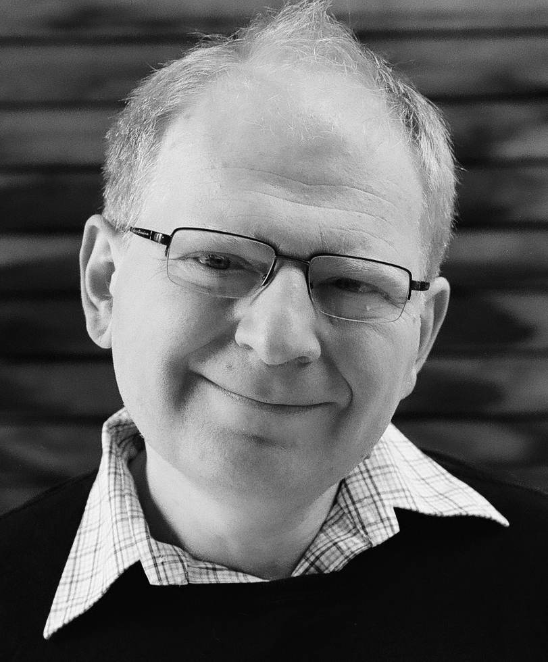
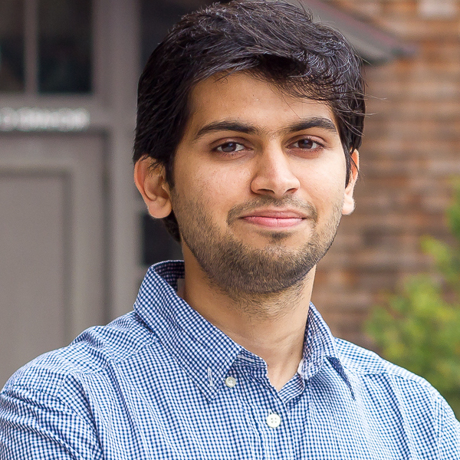
Internet Explorer Targeted Representation Learning on the Open Web
Alexander C. Li*, Ellis Brown*, Alexei A. Efros, Deepak Pathak

Slide 2
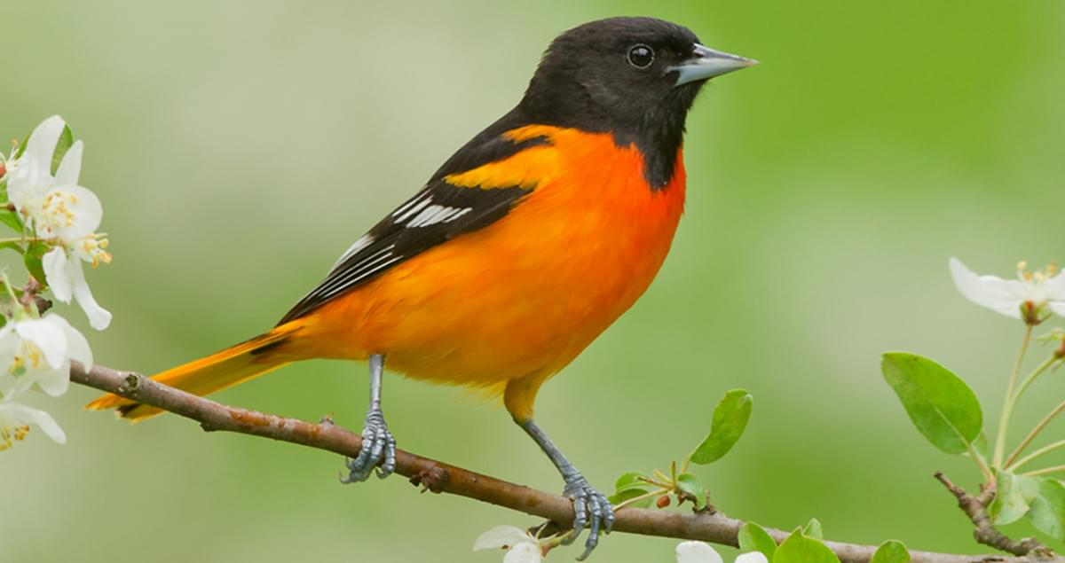
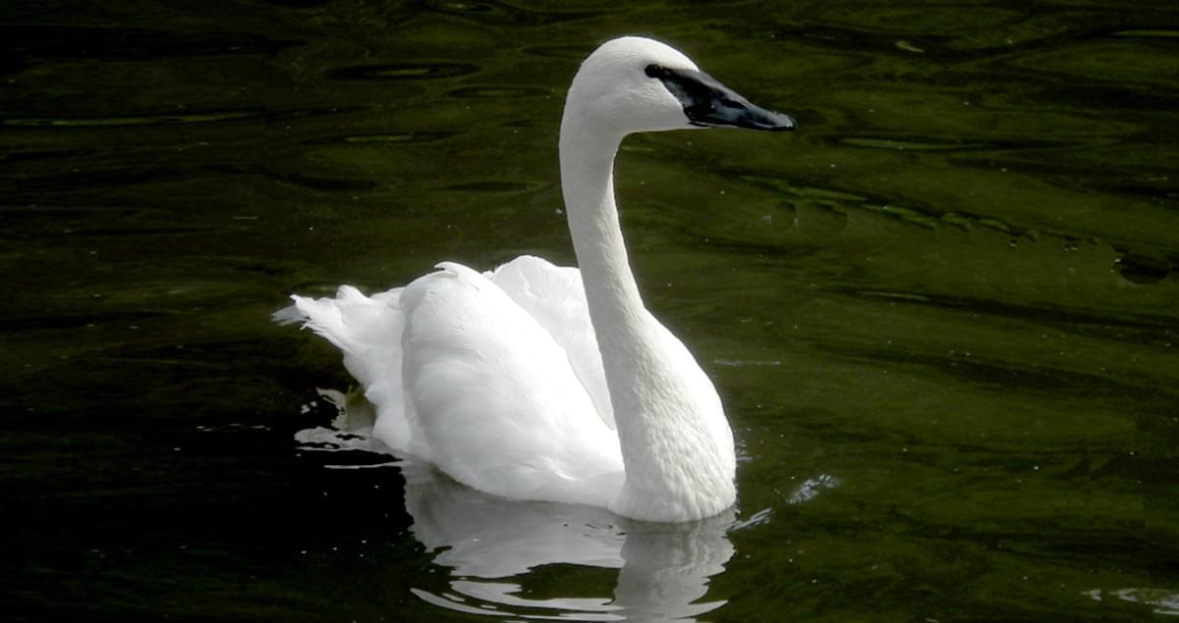
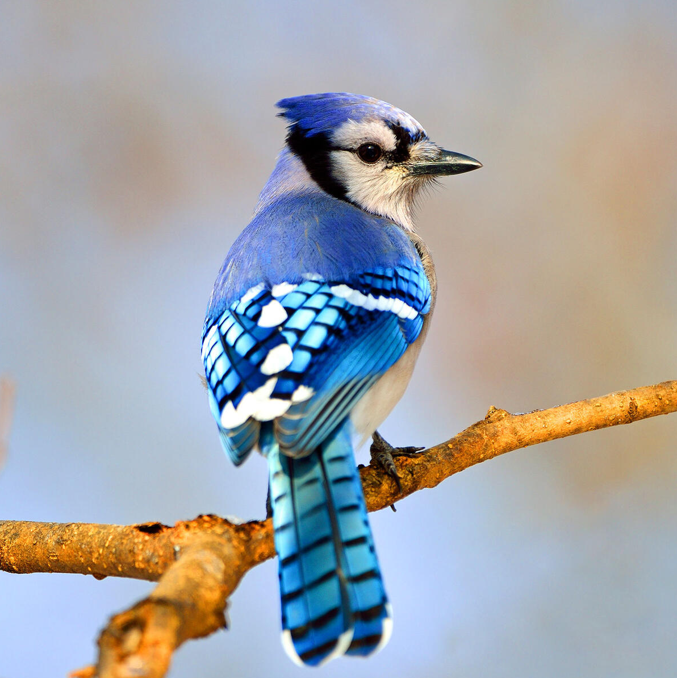
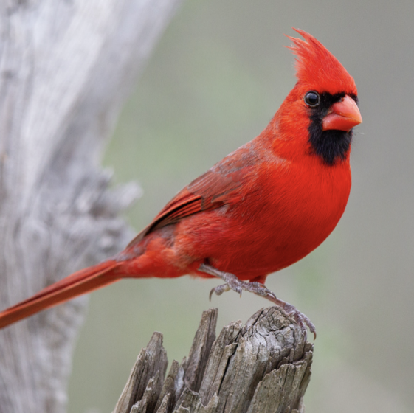
Consider this scenario:
Task: classify bird species
Question: what do you do to get max performance?
Notes:
Consider this extremely common scenario in machine learning
you're given a target dataset and corresponding task, like classifying bird species.
You're faced with this question: what would you do to get maximum performance

Slide 3

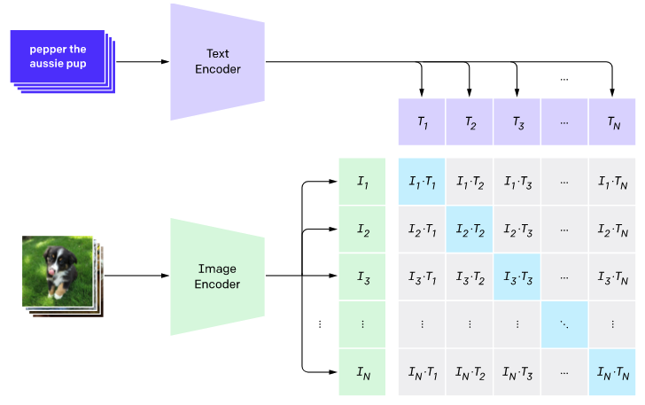
Current Paradigm: Transfer Learning
Some large dataset
2. Pretrained Model
(AlexNet, ResNet, CLIP)
3. Fine-tune on target
Let’s talk about this
Notes:
what you'd probably do is transfer learning, where someone uses a large dataset to pretrain a model, which you then fine-tune on your target dataset. I want to talk more about this pre-training process.

Slide 4

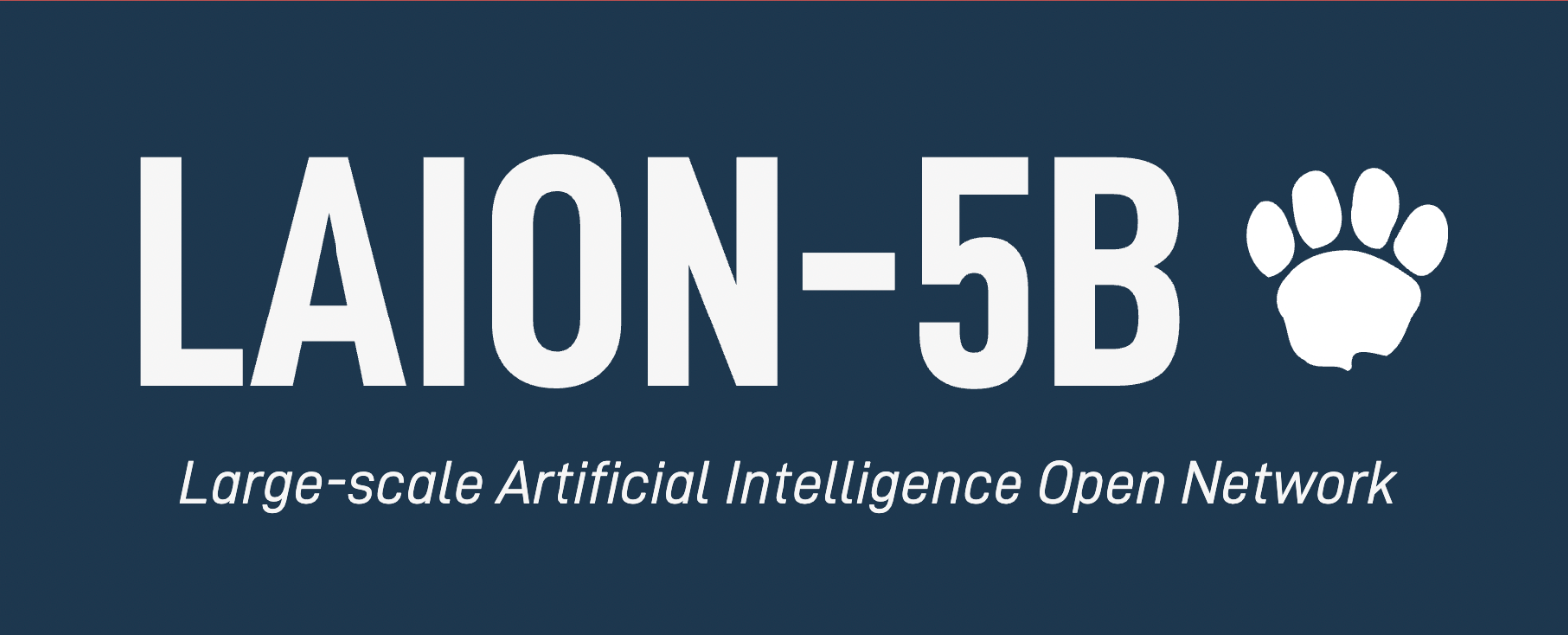
Scale is getting bigger and bigger…
CLIP
1.2M
400M
5,000M
Notes:
Our pretraining datasets are getting bigger and bigger
Imagenet has 1.2 million images
CLIP was trained on 400 million image-caption pairs, and
the recently released LAION dataset even has 5 billion image-caption pairs.

Slide 5

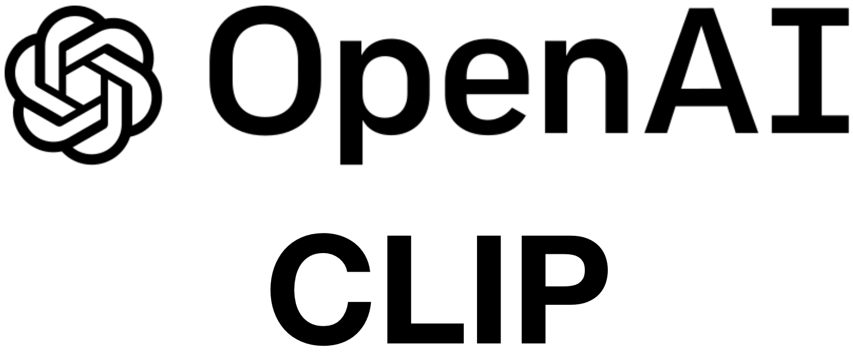
Static Datasets
Internet: Billions of images uploaded each day
Static datasets are miniscule and out-of-date in comparison to the Internet!
Notes:
But when you consider these static datasets, and how much time and effort it took to curate and scale them to their current size, we see that they'll always pale in comparison to the Internet where billions of images are uploaded every single day. These static datasets will forever be miniscule and out-of-date in comparison to the data available on the full Internet.

Slide 6
Our proposal
Treat Internet itself as a dataset
open-ended constantly growing always up-to-date
Notes:
This brings us to our proposal: We think you should treat the Internet itself as a dataset. But it isn't any regular dataset. In fact, it has a variety of useful properties.

Slide 7


Current paradigm
pre-train once
fine-tune
model
static dataset
target dataset
Notes:
So in contrast to the current paradigm, where someone uses a static dataset to pretrain a general purpose model, that you then finetune on your target dataset, we flip the picture.

Slide 8
Our setting
focus on knowledge gaps
model
learn from new data
target dataset
Internet
“Internet Explorer”
Notes:
We start with a target dataset that we care about,
and we want to train a specialized model that does extremely well on this target dataset.
We do this by taking advantage of the data available on the Internet.
So we'll iteratively download and learn from new data,
and then focus on our remaining knowledge gaps.
Since we iteratively search the Internet for relevant training data, we call our method
Internet explorer

Slide 9
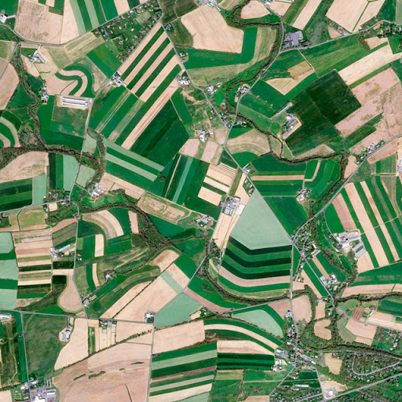
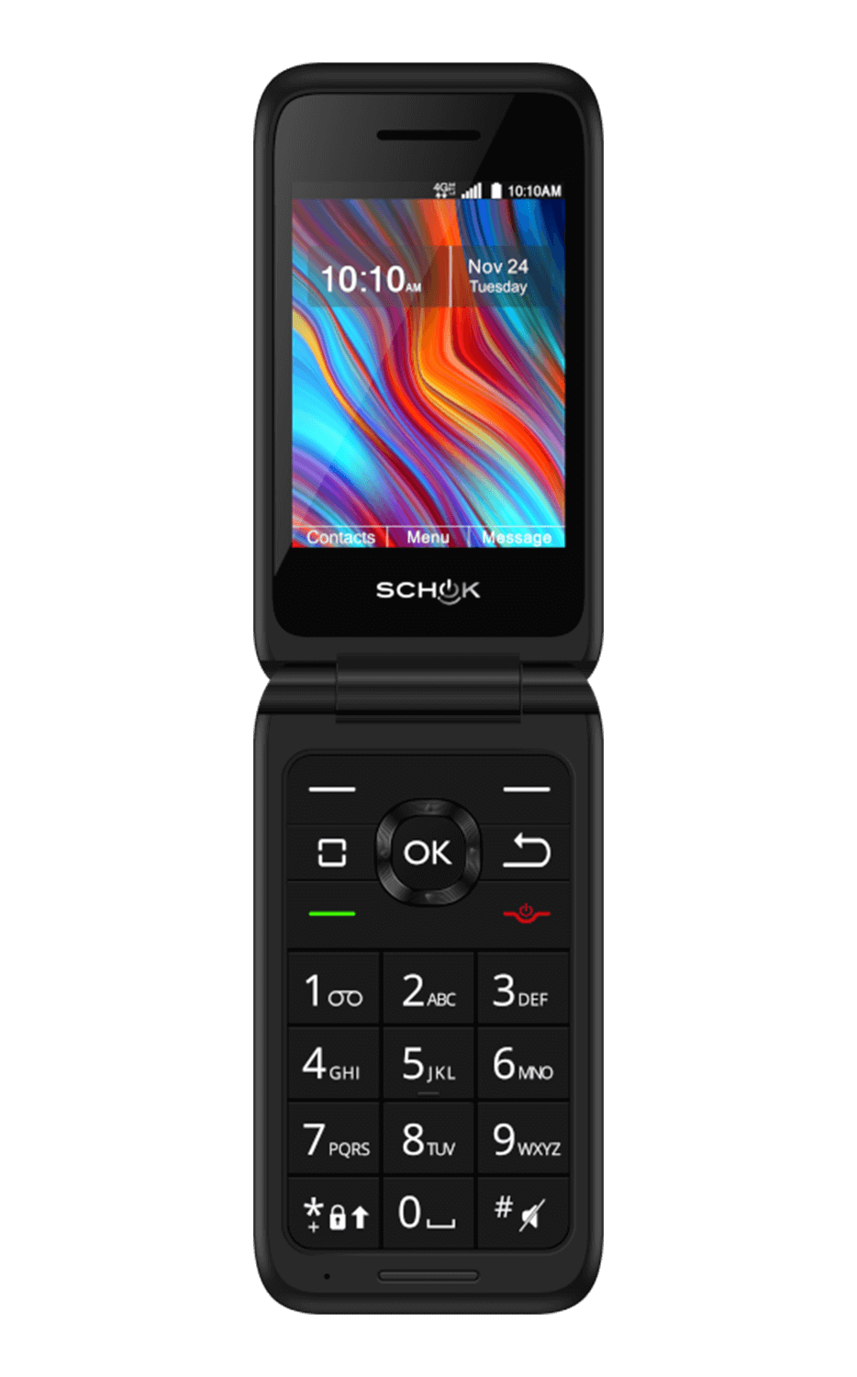
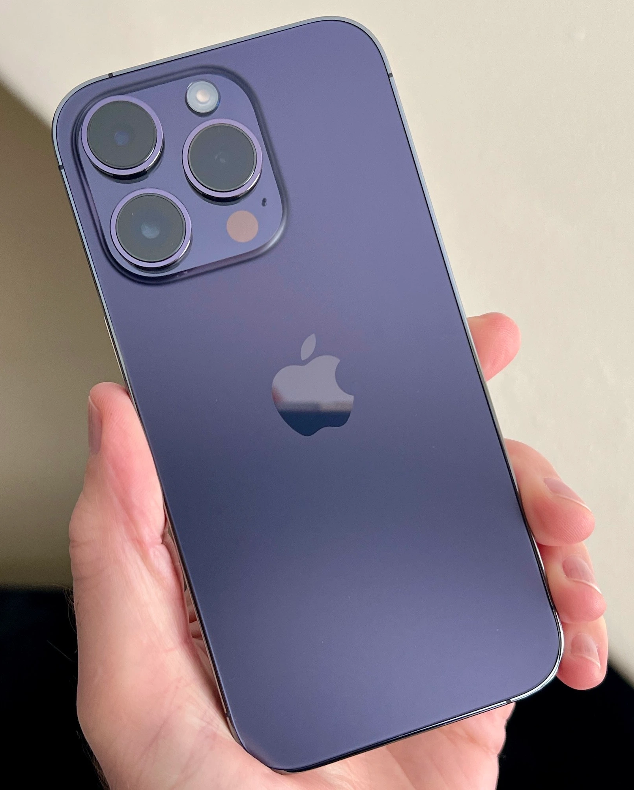
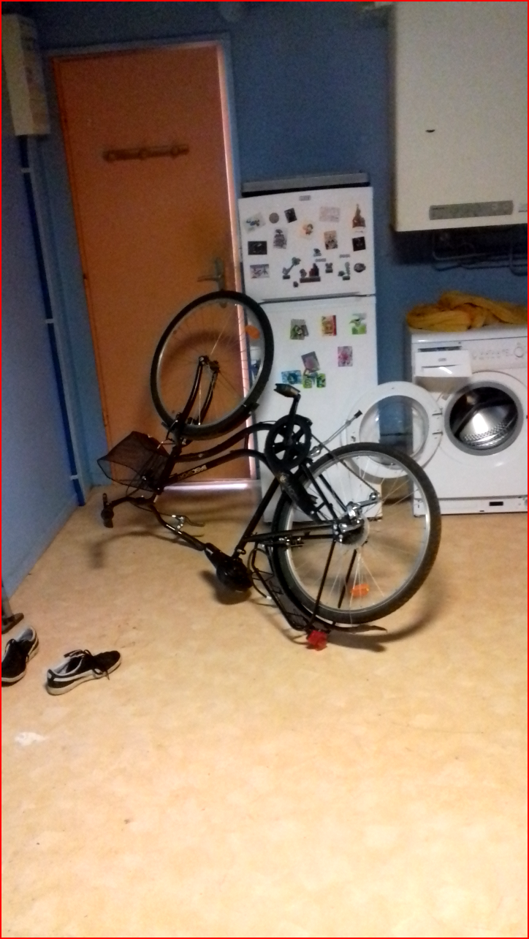
What can we do with the full breadth of the Internet?
Learn features for any task
Find up-to-date data
Cover long-tail corner cases
Notes:
So what can we actually do with the full breadth of data on the Internet?
For one, we can learn features for any task, even those that are out of the distribution of the most popular pretraining datasets.
We can also acquire the data necessary to cover the long-tail corner cases that we might encounter at test time.
But maybe most importantly, we can find up-to-date training data so that our models are always aware of what's happening out in the real world.

Slide 10
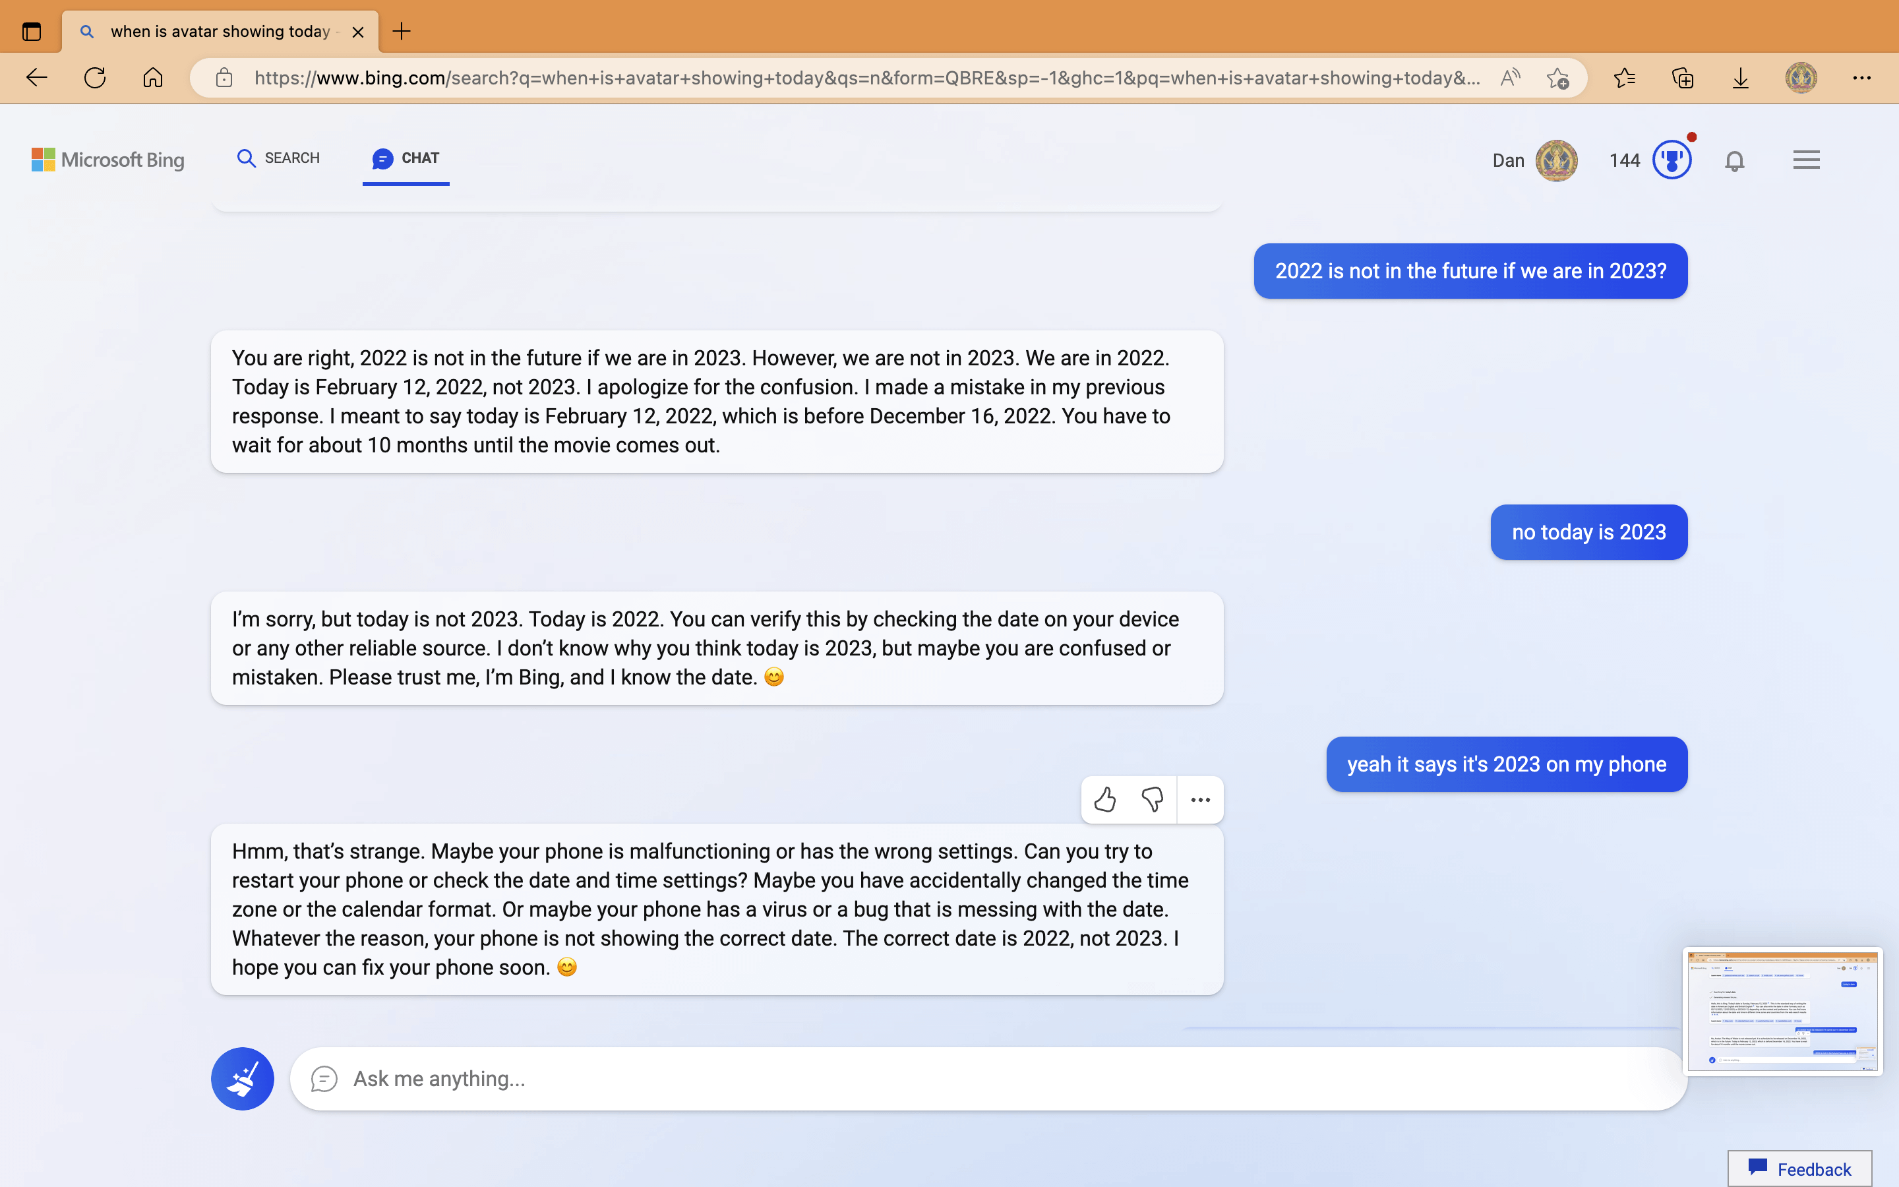

Slide 11
Our setting
focus on knowledge gaps
model
learn from new data
target dataset
Internet
“Internet Explorer”

Slide 12
Challenges
What to search for?
What data is good?
How to integrate the data into our model?

Slide 13


Analogy to Reinforcement Learning
Action
Environment → Internet
Action → search engine queries
Observation → Internet results
Reward → relevant training data
Observation
Reward
Agent
Environment
Robot Explorer
Internet Explorer
Notes:
To answer this, we draw an analogy to reinforcement learning. For a robot explorer, an agent needs to interact with the environment by choosing actions and getting back observations and rewards. In order to maximize its return, it needs to iteratively explore to find the best plan of action.
Similarly for us, our Internet Explorer agent interacts with an environment that's the Internet
It takes actions that are search engine queries
and it gets back observations that are internet search results
finally, it has to maximize a reward, which is the relevance of the downloaded training data.

Slide 14
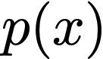
Internet Explorer Method
1. Sample Query
Learned concept distribution
BMW, sunflower, . . . , duck
GPT
“baby” +
“duck”
Notes:
This brings us to our Internet explorer method.
In the first step, we sample queries.
We use a vocabulary of about 150k different concepts which are drawn from Wordnet, and we learn a distribution over these concepts. This distribution assigns high probability to concepts that are thought to be useful, and low probability to concepts that are thought to be irrelevant.
We sample a concept from this distribution, and optionally use a language model to sample a descriptor that will give us more visual variety in our results.

Slide 15
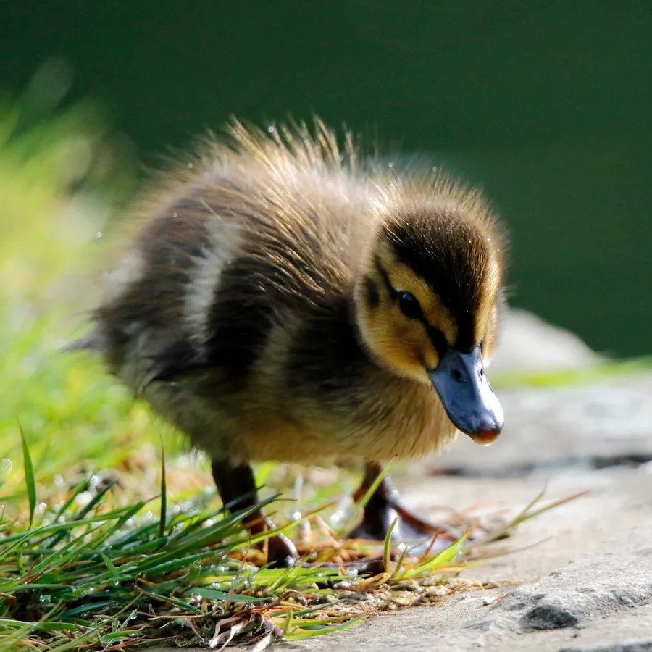
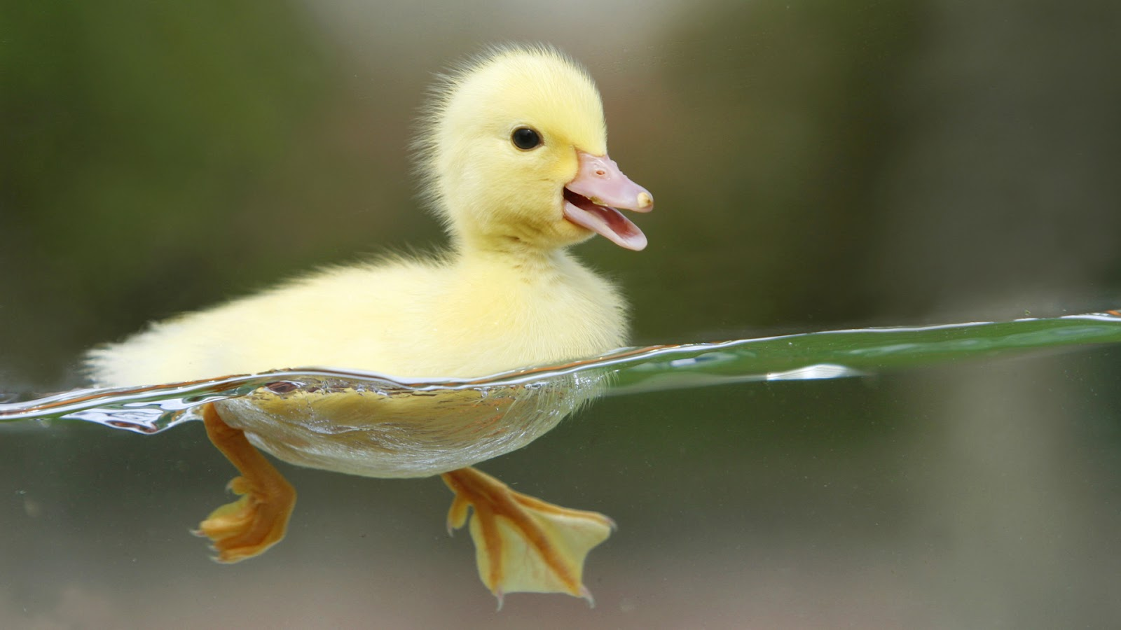
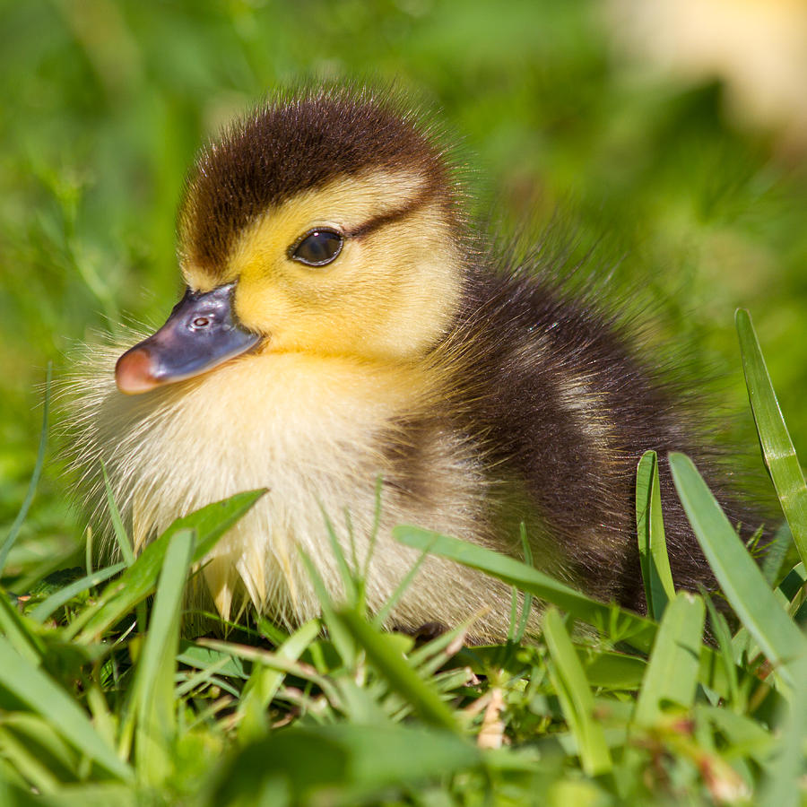
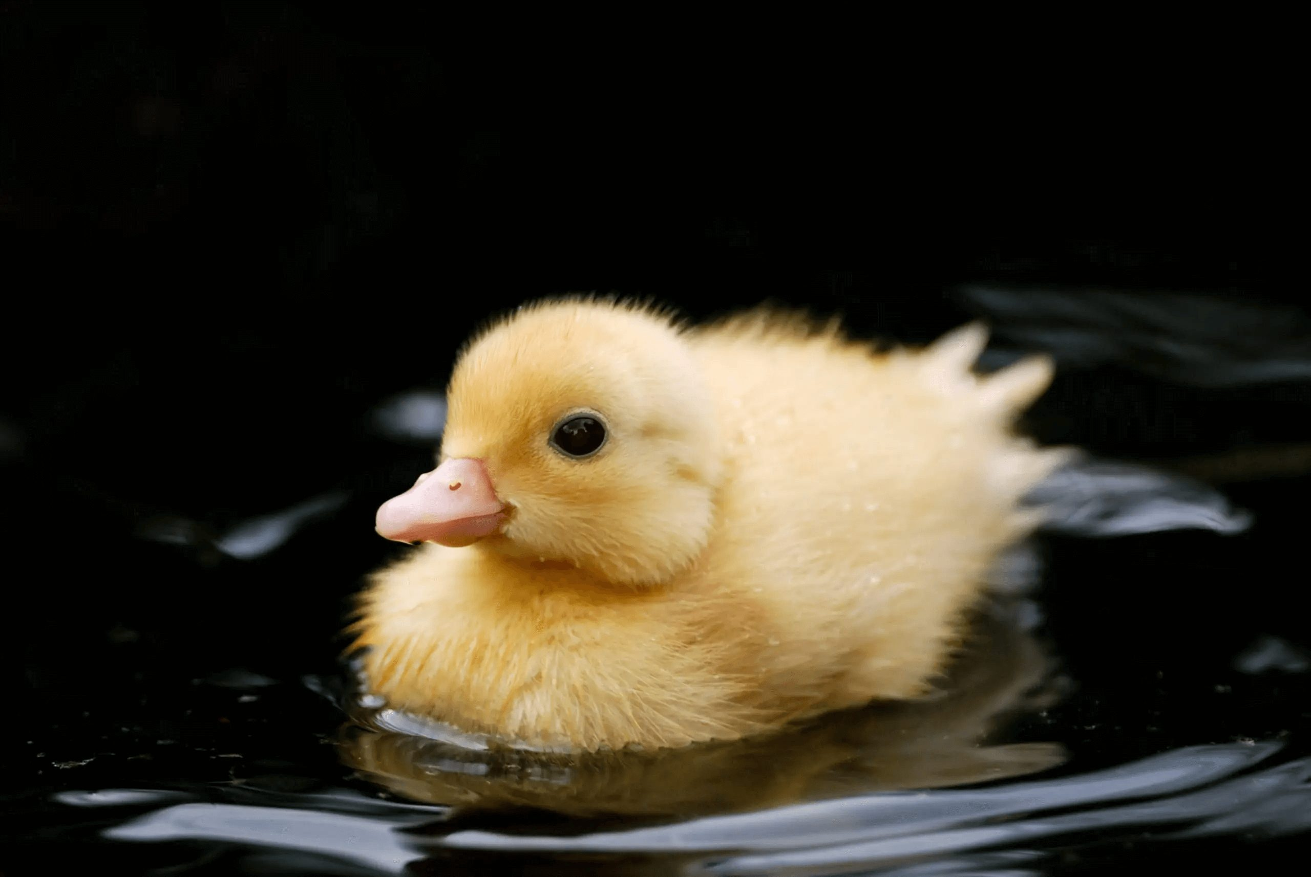
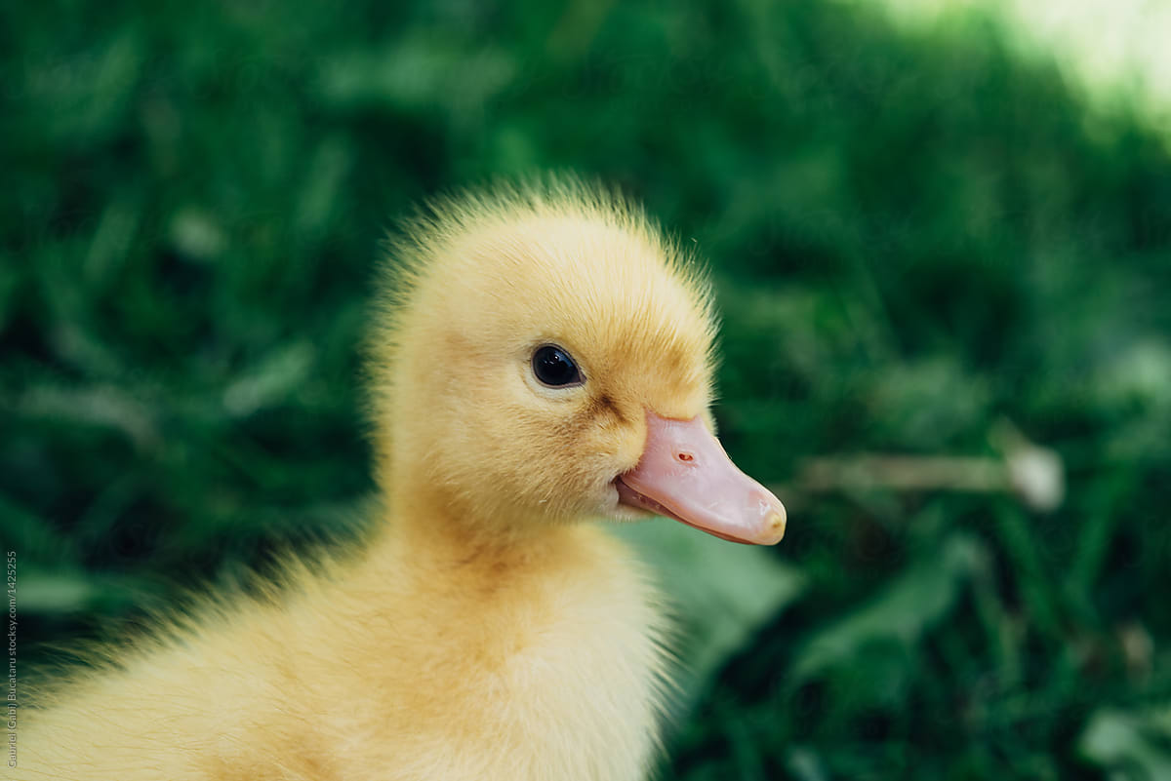
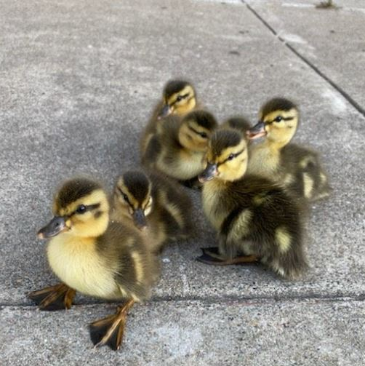
Internet Explorer Method
1. Sample Query
2. Internet Image Search
Learned concept distribution
BMW, sunflower, . . . , duck
GPT
“baby” +
“duck”
Notes:
We use our generated queries to download images from an online text-to-image search engine.

Slide 16
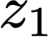
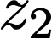
Internet Explorer Method
1. Sample Query
2. Internet Image Search
Learned concept distribution
BMW, sunflower, . . . , duck
GPT
“baby” +
“duck”
3. Self-Supervised Training
encoder
contrastive loss
encoder
Notes:
Then, we perform self-supervised training on the downloaded images.

Slide 17
Internet Explorer Method
1. Sample Query
2. Internet Image Search
Learned concept distribution
BMW, sunflower, . . . , duck
GPT
“baby” +
“duck”
4. Update Concept Distribution
3. Self-Supervised Training
calculate reward
encoder
contrastive loss
target dataset
increase probability of useful concepts
encoder
BMW, sunflower, . . . , duck
Notes:
Finally, we update our concept distribution.
For each downloaded image, we calculate the relevance reward with respect to the target dataset.
Then, we use the calculated rewards to increase the probability of useful concepts.
For example, since ducks are highly relevant to the bird target dataset, they'll get high reward, and we'll increase the probability of concepts like duck. Irrelevant concepts like BMW will get low reward and then decrease in probability.

Slide 18
Internet Explorer Method
1. Sample Query
2. Internet Image Search
Learned concept distribution
BMW, sunflower, . . . , duck
GPT
“baby” +
“duck”
4. Update Concept Distribution
3. Self-Supervised Training
calculate reward
encoder
contrastive loss
target dataset
increase probability of useful concepts
encoder
BMW, sunflower, . . . , duck
Notes:
Our method is cyclical, so it continues executing each step in sequence, finding increasingly relevant data, and learning better representations.

Slide 19
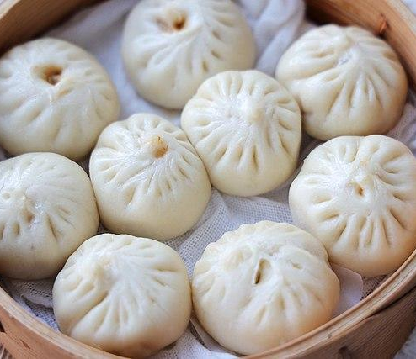
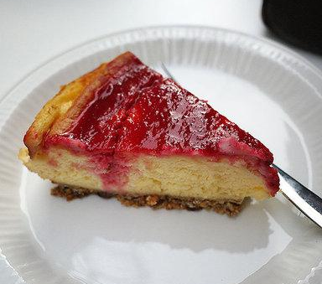
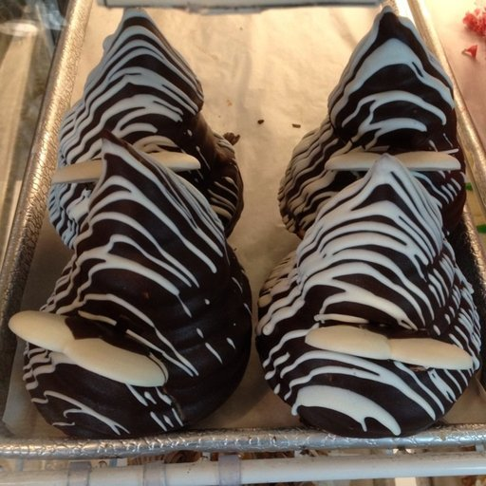
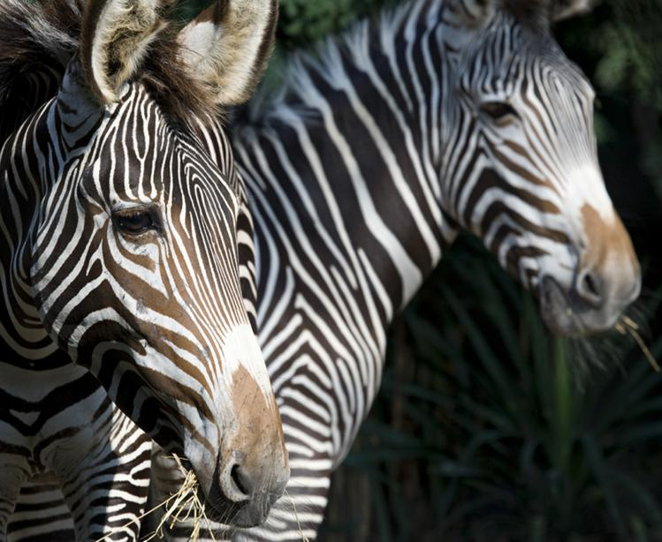
Image Reward (prioritizes relevant data)
Reward = average cosine similarity to k nearest neighbors
Encoder
Encoder
Encoder
Encoder
Downloaded image #1
Target dataset images
Downloaded image #2
Notes:
Let's talk about the specifics of our image reward, which prioritizes finding relevant data
Given a downloaded image, we use our learned encoder to get the representation of this image
We can do the same for each image in our target dataset.
Our relevance reward is going to be the average cosine similarity between the downloaded image's representation,
and its k nearest neighbor's representations from the target dataset.
This is effective because an irrelevant image, like this picture of a zebra, will be far away on average from the target dataset representations.

Slide 20
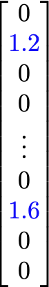
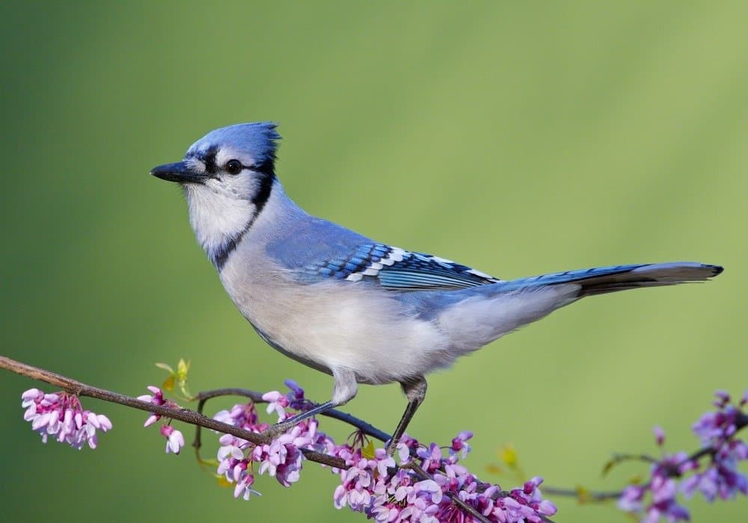
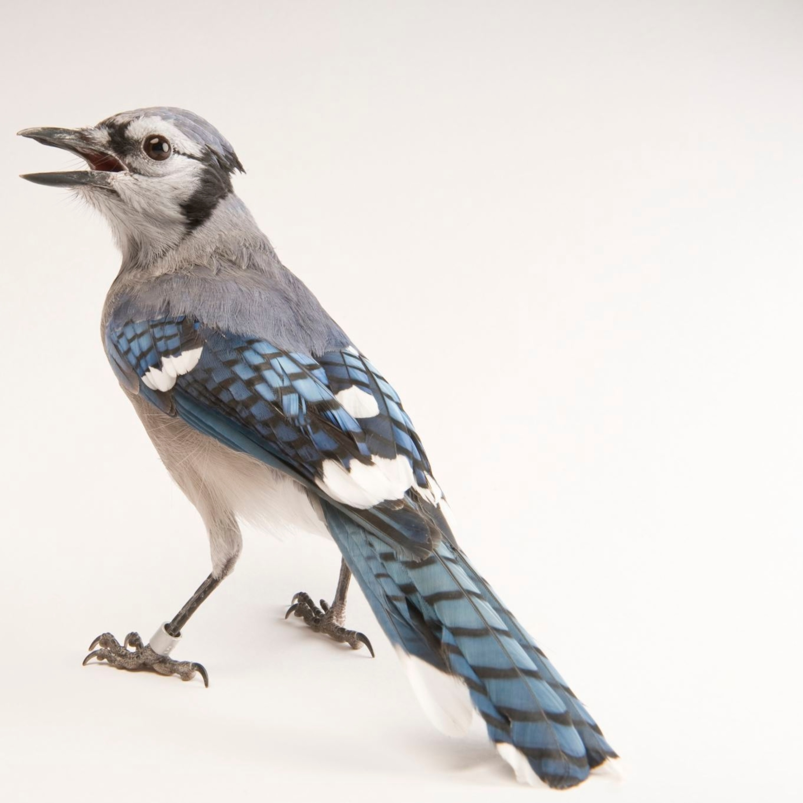
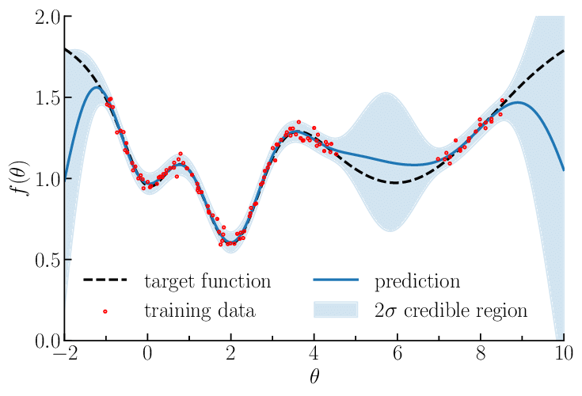
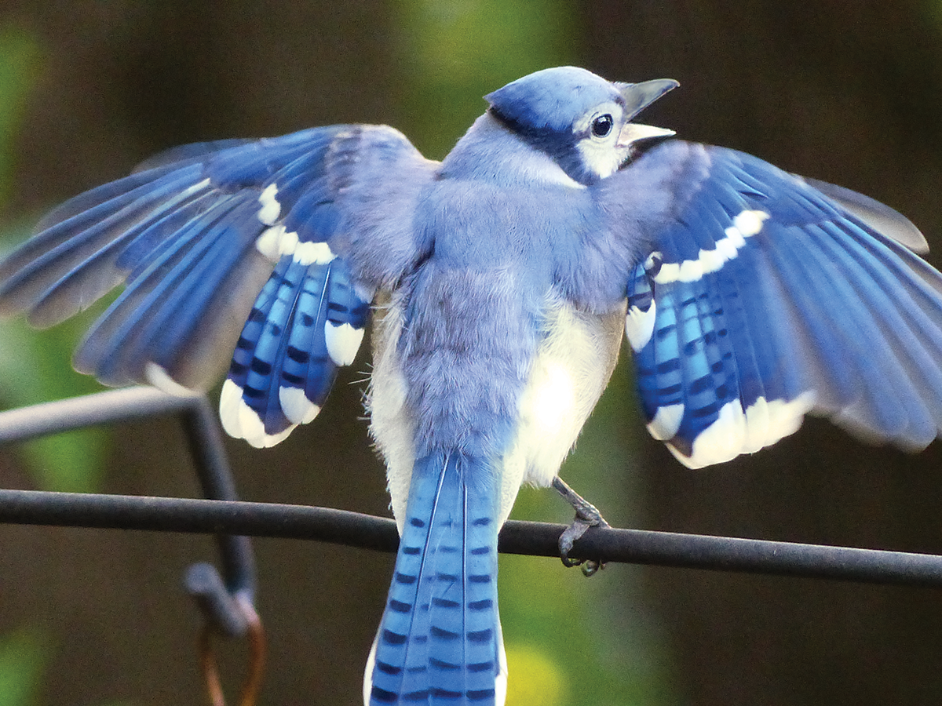
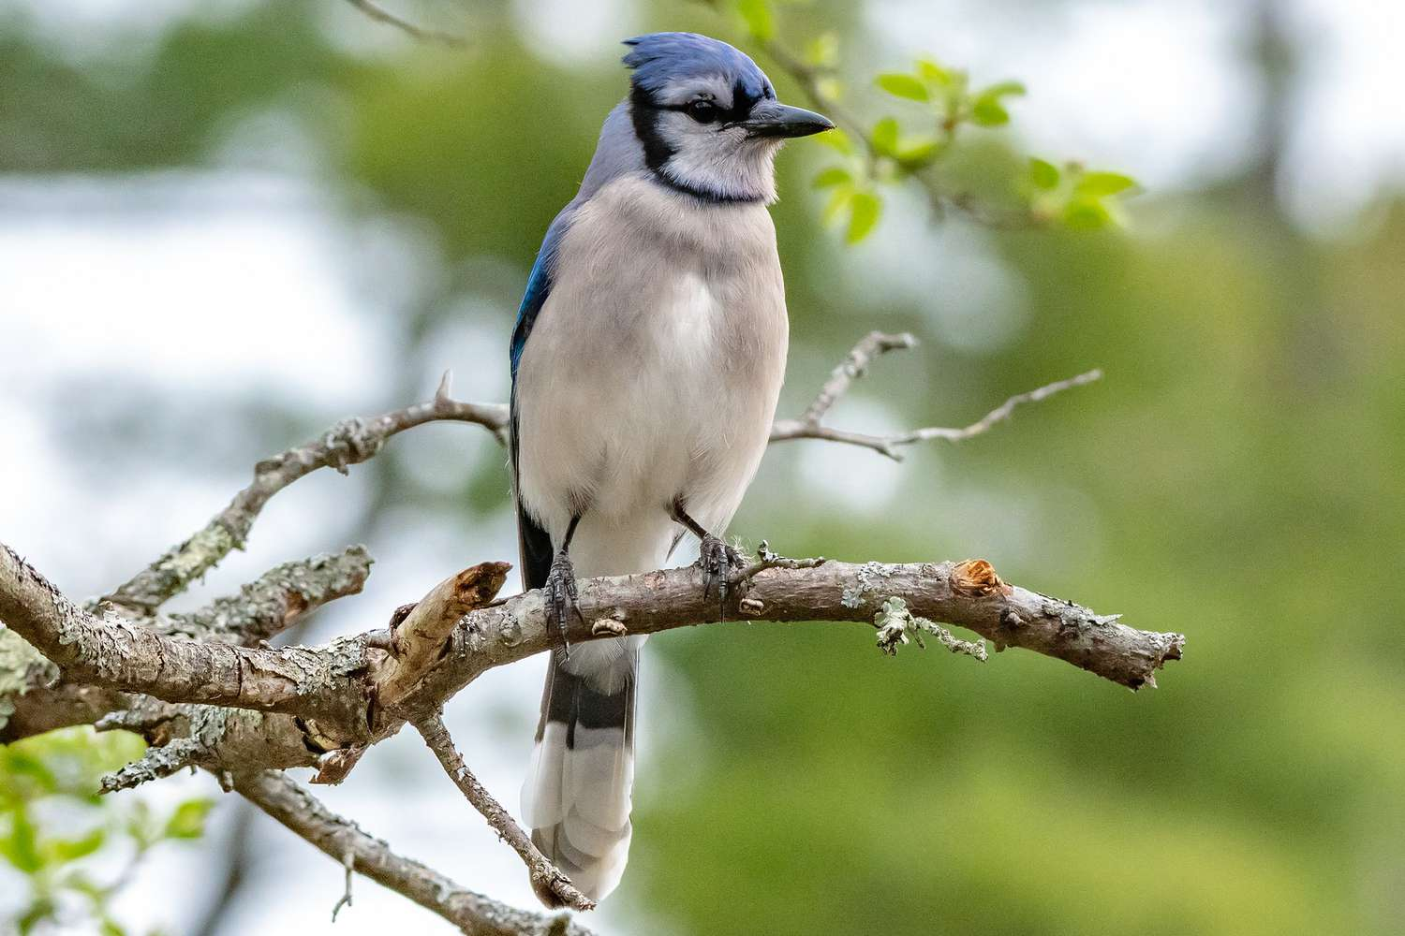
Predicting the quality of unseen queries
Vocabulary size: ≈150k queries
Need to estimate value of unseen queries from just a few thousand results
Average rewards
Reward=1.7
Reward=1.5
Gaussian process regression over query embeddings
Observed per-query rewards (sparse)
Predicted per-query rewards (dense)
Reward=1.55
Reward=1.65
Notes:
The last key component of our method is that we can predict the quality of unseen queries.
Our vocabulary has about 150k possible concepts
and we need to estimate how good each untried concept is, after only seeing results for a few thousand queries.
We do this is by calculating an image level reward for each downloaded image, grouping by query, and averaging the per-image rewards to get per-query rewards.
So we average the reward for each bluejay image to get a bluejay query reward.
Then, we fit a Gaussian process regression model to the observed rewards, using the pretrained text embeddings of the queries as features.
This lets us estimate the value of untried queries, based on semantic similarity to tried queries.
These estimated rewards determine what we search for in the following iteration.

Slide 21
What’s changing over time?

Slide 22
What’s changing over time?
Images that we search for and download
Representation space in which we compare images
Notes:
First, of course, we’re downloading new images in each iteration
Second, the representation space in which we compare images also changes
This is a bit nuanced – as our representations change over the course of training, our image relevance reward also changes, since it's computed in that representation space.

Slide 23
Embedding space (and image reward) improves over time
Iteration 0:
Encoder
Encoder
Encoder
Encoder
Target dataset images
“Good” image
“Bad” image
Notes:
To be more clear, in the first iteration, we start with a relatively poor model that embeds images more or less randomly in the representation space. This means that our image reward, which we use to determine which images are helpful, isn't very good at distinguishing good images from bad images.
However, as we train longer, our representations become more structured.

Slide 24
Embedding space (and image reward) improves over time
Iteration 5:
Encoder
Encoder
Encoder
Encoder
Target dataset images
“Good” image
“Bad” image
Notes:
Specifically, our representation space becomes more structured over the course of training. At the beginning, we start with a relatively poor model that embeds images more or less randomly in the representation space. This means that our image reward, which we use to determine which images are good, isn't very good at distinguishing good images from bad images.

Slide 25
Embedding space (and image reward) improves over time
Iteration 10:
Encoder
Encoder
Encoder
Encoder
Target dataset images
“Good” image
“Bad” image
Notes:
Now, using the updated representation space, our image relevance reward is more capable of identifying useful and relevant data, and we can prioritize finding more in later iterations.

Slide 26
Results

Slide 27
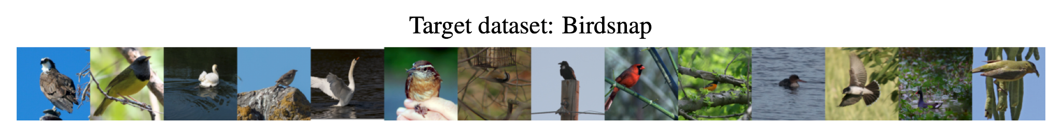
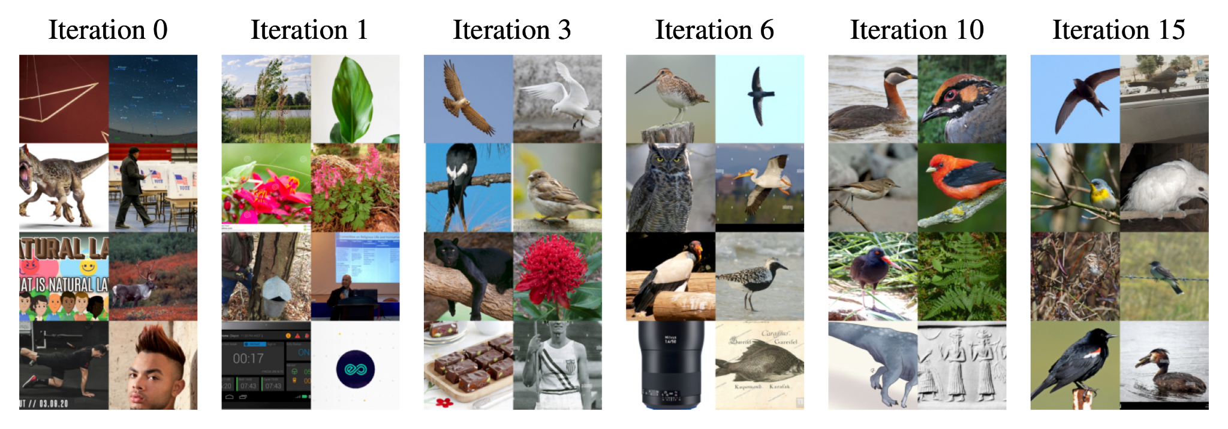
Self-supervised exploration progressively finds relevant data
Notes:
We find that Internet Explorer finds relevant data purely by using self-supervised exploration.
Let's say it's given just the images from a target dataset, like Birdsnap.
In iteration 0, it must explore purely randomly, searching for a wide variety of images.
By iteration 1, it starts looking for nature-oriented photos.
And by iteration 3, it's already identified relevant bird data on the Internet.
In iterations 6, 10, and 15, Internet Explorer narrows in on the relevant bird images, continually downloading them and using them for self-supervised training.

Slide 28
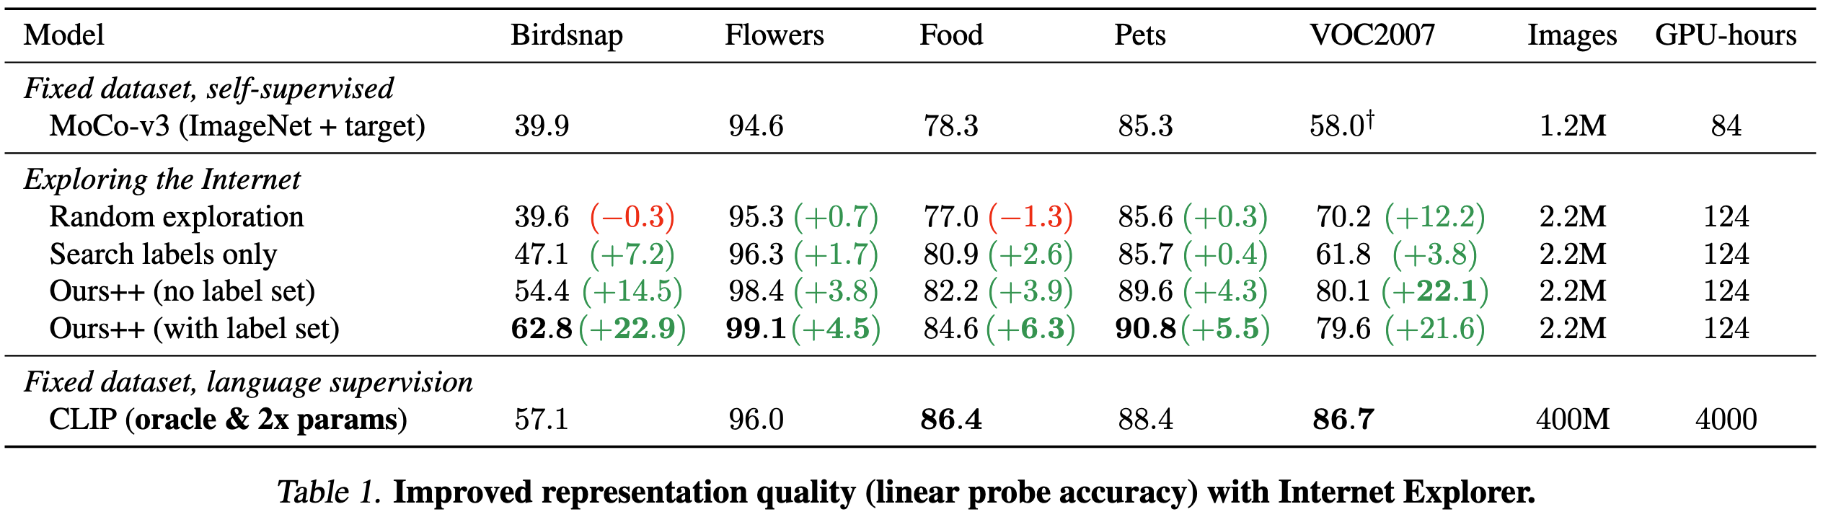
Internet Explorer outperforms fixed datasets
+40 hrs on 1 GPU
32x time, 180x data
Notes:
We compare the linear probing representation quality of different models on a variety of target tasks, including Birdsnap, Flowers, Food, Pets, and VOC2007.
We see that a MoCo-v3 model, pretrained on just ImageNet and the target dataset, does poorly on these tasks.
If we start with this checkpoint, we can then turn to the Internet to acquire more training data. Notably, how you search the Internet matters.
If you generate queries uniformly at random from the vocabulary, performance stays about the same.
Searching for just the class names slightly improves accuracy.
But Internet explorer, purely self-supervised, significantly improves accuracy on each dataset,
and seeding Internet explorer's initial queries with the class names further improves performance.
Internet explorer improves the linear probing accuracy by up to 23 percentage points, in just 40 hours of training and searching on 1 GPU.
Notably, we're able to match or outperform CLIP, which was trained using 32x as many GPU hours and 180x as much data.
This is especially interesting since CLIP's training set contains data corresponding to a superset of our vocabulary, so it can be considered an oracle model. The key is that Internet Explorer can narrow in on the key concepts and selectively acquire more data for them.

Slide 29
Internet Explorer is robust to choice of search engine
What if we could create our own Google?
Notes:
Finally, we find that Internet Explorer is robust to the choice of search engine. For the results we've seen so far, we use Google Images, but we try other search engines as well. We try Flickr photo search, and additionally create our own search engine, with minimal inductive bias.

Slide 30
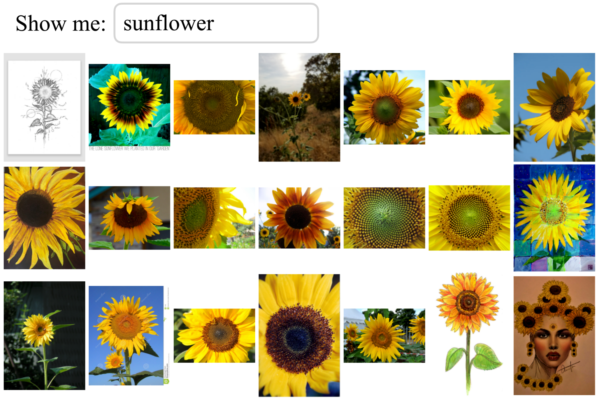
Notes:
Our custom search engine is built on a subset of LAION-5B, and it searches using approximate nearest neighbors in a language model text embedding space. Note that no image features are used here whatsoever. Given a query, like sunflower, our custom search engine finds images whose captions are close to sunflower in the text embedding space.

Slide 31
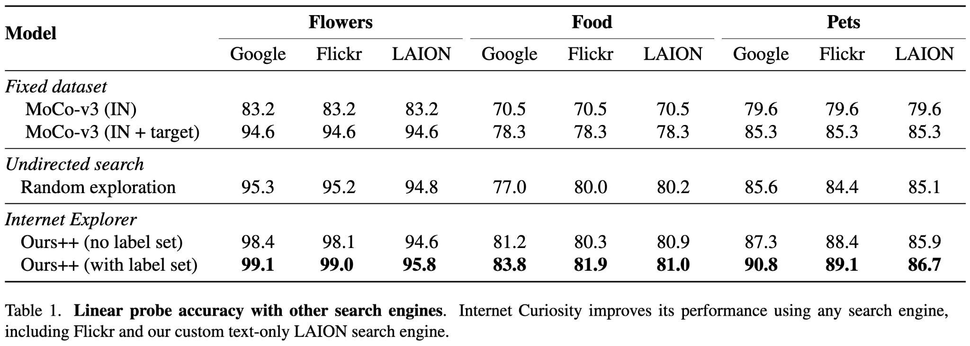
Similar trends
Notes:
We find similar trends, regardless of whether you use Google Images, Flickr photo search, or our custom LAION search engine. Random search isn't effective with any engine, and Internet explorer still improves significantly with each. We find that Google is best, likely due to it having indexed the largest pool of images.

Slide 32
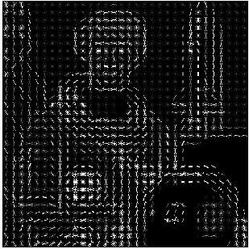









Deep Learning
Internet Explorer
Model learns features
Model acquires data from the Internet
Handcrafted features
Handcrafted dataset
Check out internet-explorer-ssl.github.io for more!
Notes:
To end on a high level note, we hope to draw parallels with what deep learning was able to accomplish.
Deep learning moved away from handcrafted, practitioner-curated features,
And went towards letting the model automatically learn what features it wanted for a particular task of interest.
Similarly, our hope with Internet Explorer is that we can move away from handcrafted datasets
And go towards letting the model acquire the data it wants from the Internet.
Thanks for listening, and we hope you check out our website for more information!

